Slide 1

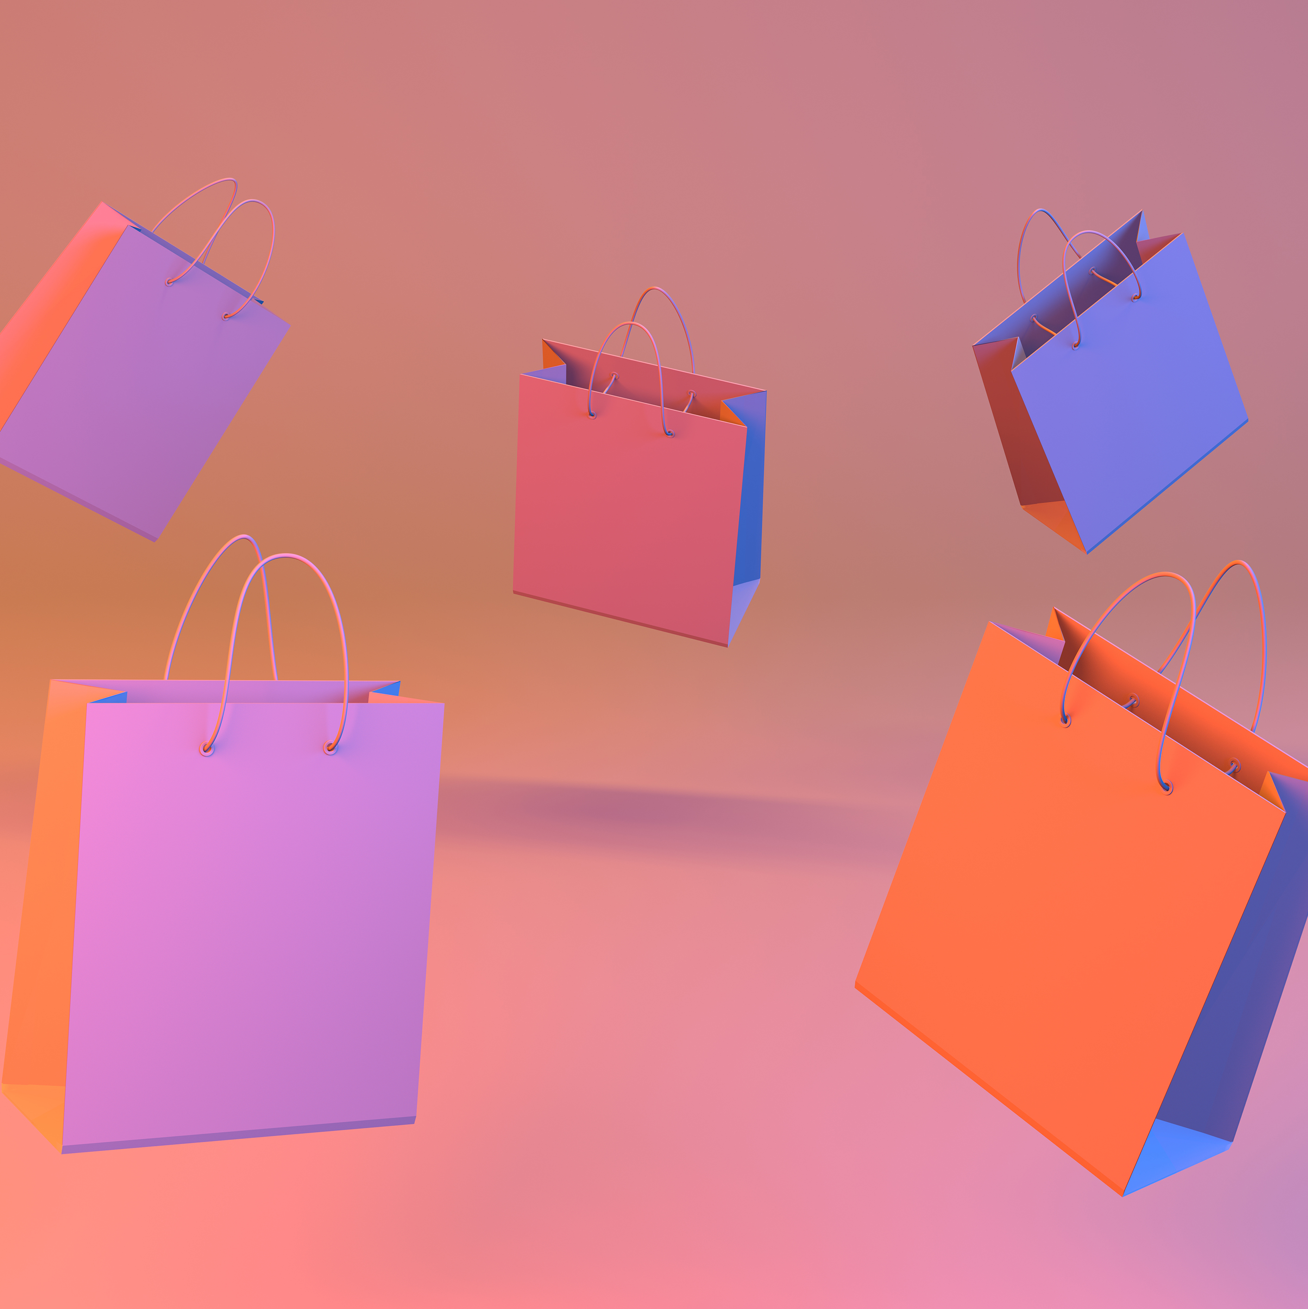

USA Consumer Behavior and Shopping Trends
Nidhi Ojha
01/08/2024

Slide 2
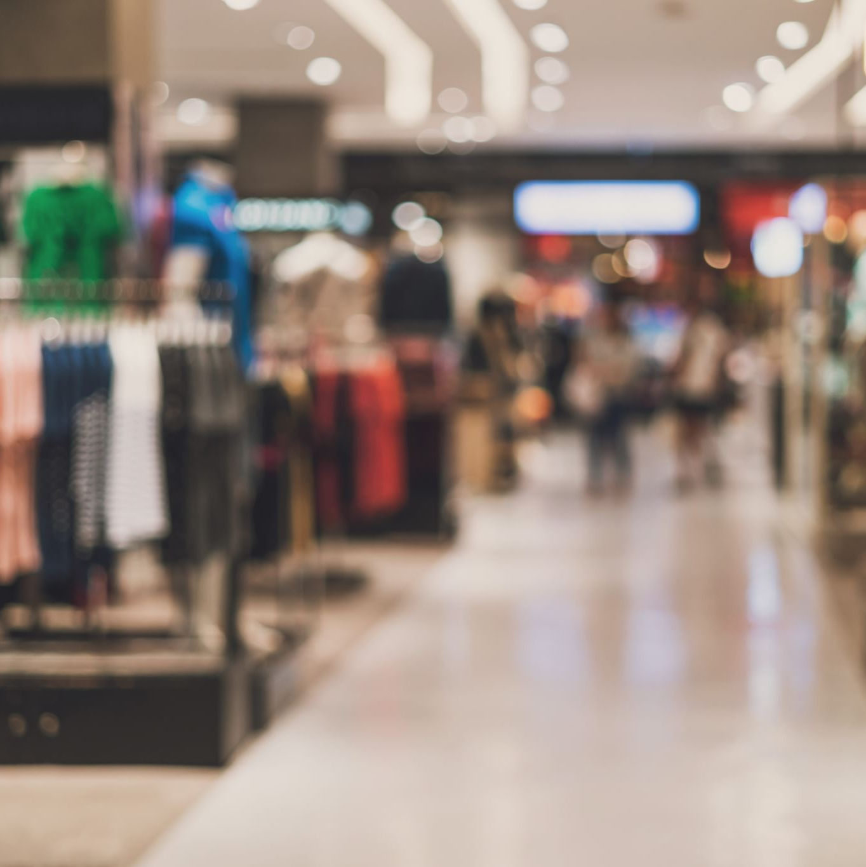

Agenda
Meet the Presenter
What is Consumer Behavior?
What is Shopping Trend?
Project Overview
Architecture
Dataset Explanation
Dashboard
Map
Ethical Considerations
Key Takeaways
Conclusion

Slide 3
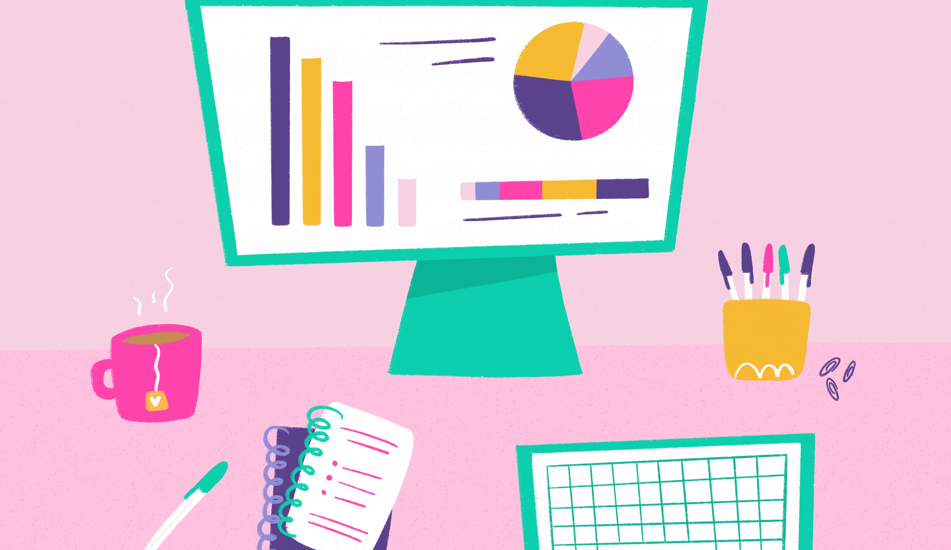
Meet the presenter
Greetings! I'm Nidhi, a Technical Program Manager at Whole Foods Market. I am excited to embark on this transformative journey through the Data Analysis and Visualization Bootcamp. With a strong commitment to excellence, my goal is to enhance my current role and unlock new career horizons by mastering the art of data analysis and visualization.

Slide 4
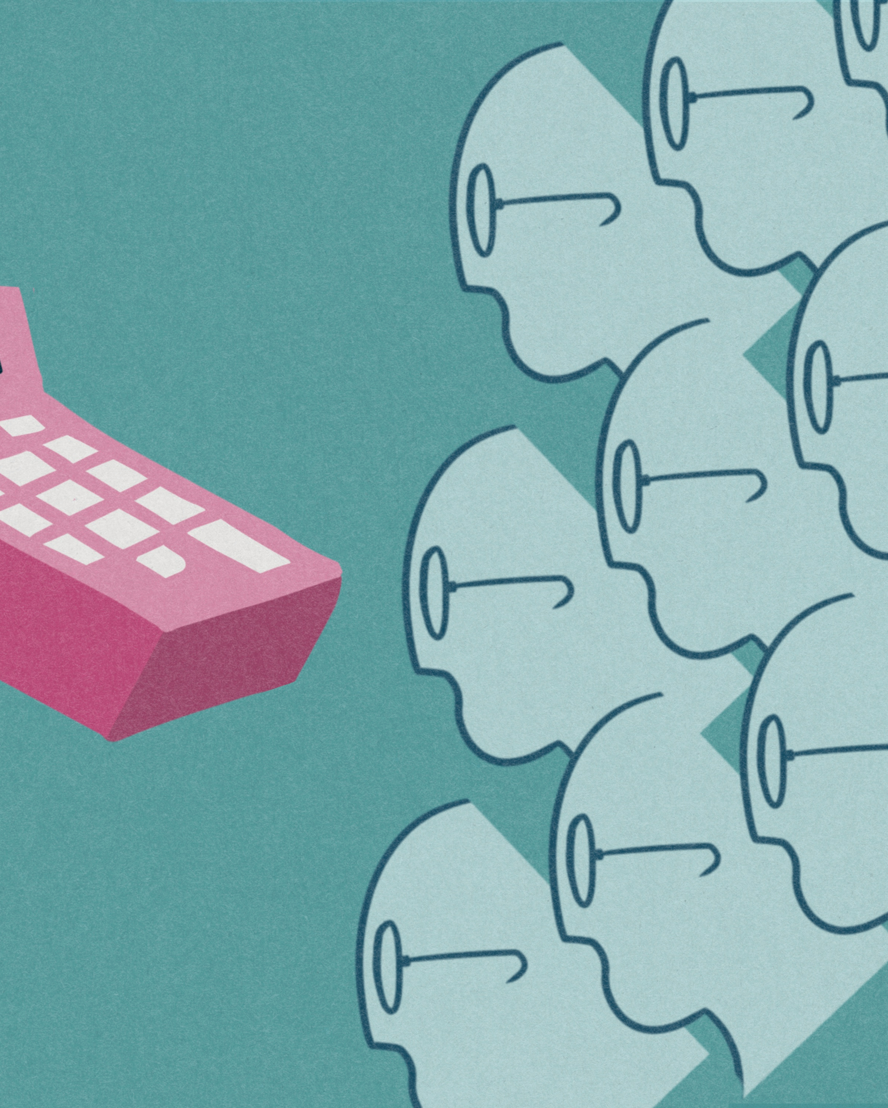
What is Consumer Behavior?
It refers to the study and analysis of the processes and activities individuals engage in when searching for, purchasing, using, evaluating, and disposing of products and services. It encompasses the psychological, social, and economic factors that influence consumers' decision-making, preferences, and actions in the marketplace. Understanding consumer behavior is crucial for businesses to tailor their marketing strategies, product development, and overall business approach to effectively meet the needs and desires of their target audience.

Slide 5

What is Shopping Trend?
It refers to a prevailing and observable pattern or behavior in consumer purchasing activities over a specific period. It encompasses changes in consumer preferences, buying habits, and the overall dynamics of how, when, and where people make purchases.

Slide 6
Project Overview
The USA Consumer Behavior and Shopping Trends Data Visualization project aims to analyze and visually represent comprehensive E-Commerce Transaction Trends within the United States. The project seeks to uncover insights into consumer behavior, shopping patterns, and market trends across various sectors. The primary goal is to provide stakeholders with a visually intuitive platform that facilitates a deeper understanding of the dynamic landscape of consumer interactions with the marketplace.
Key Components:
1
Sourcing and Cleaning
2
Advanced Data Visualization Techniques
3
Interactive Dashboard Features
4
Geospatial Insights
5
User Friendly Navigation

Slide 7





Project Architecture
USA Consumer and Shopping Trends – Data Visualization Website
(HTML, CSS, JavaScript, D3, AnyChart Visualization library)
Python
API Endpoints
(flask, flask_cors)
ORM
(sqlalchemy)
Sanitized
Shopping Trends DB (SQLite)
Data Source

Slide 8
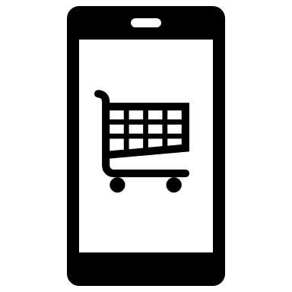


You cannot take the consumers for granted anymore, therefore a sound understanding of consumer behavior is essential for the long run success of any marketing program

Slide 9
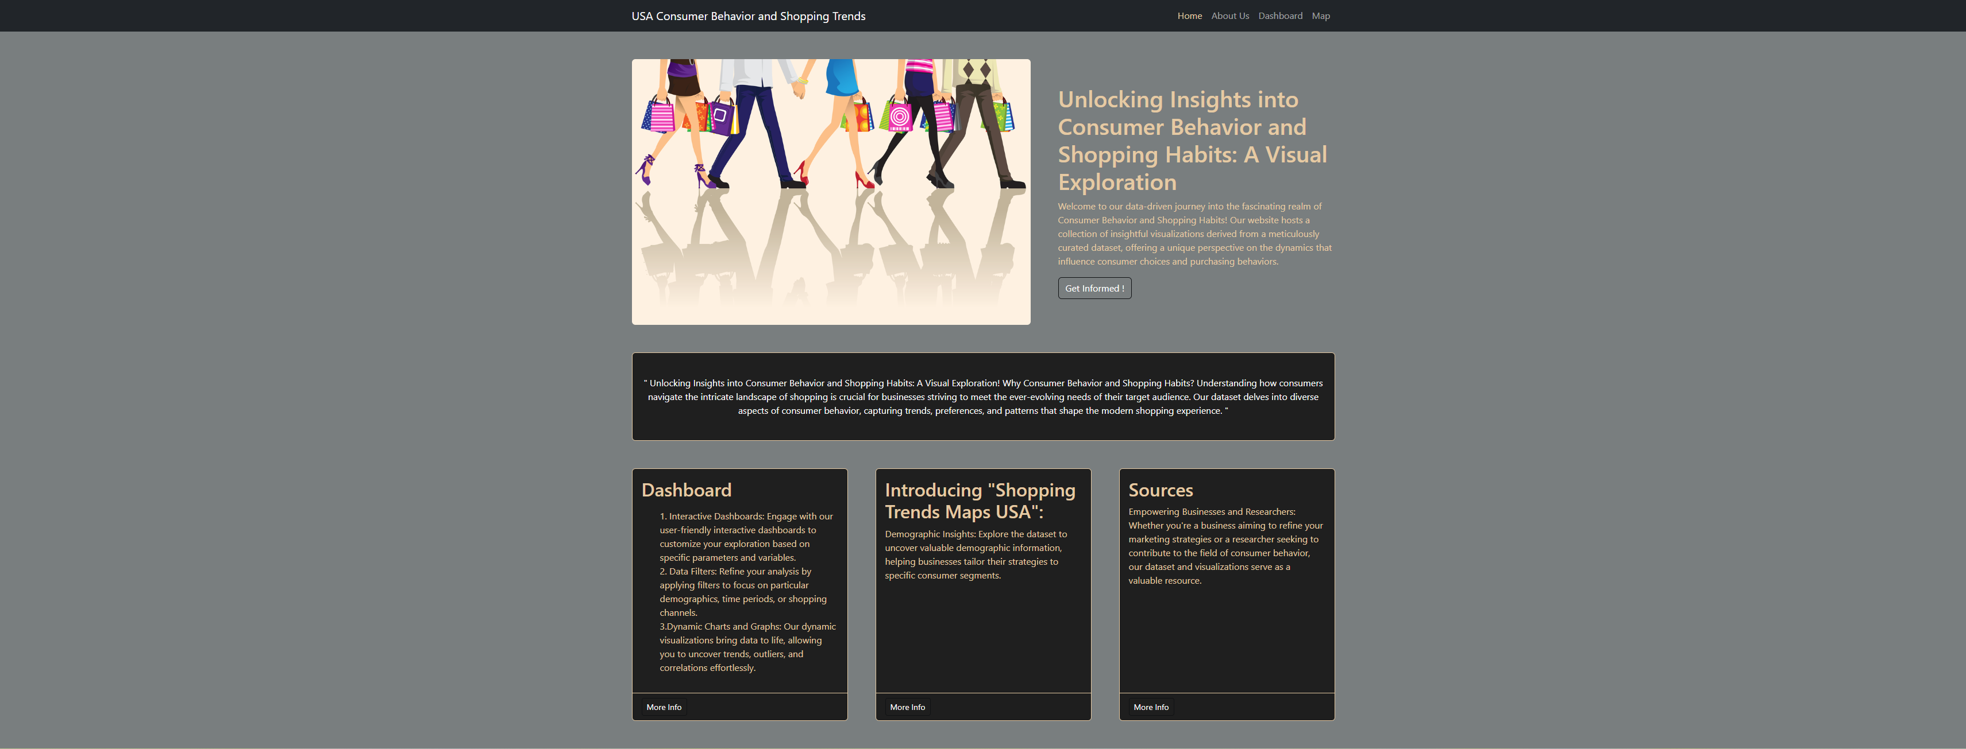
USA Consumer Behavior and Shopping Trends

Slide 10

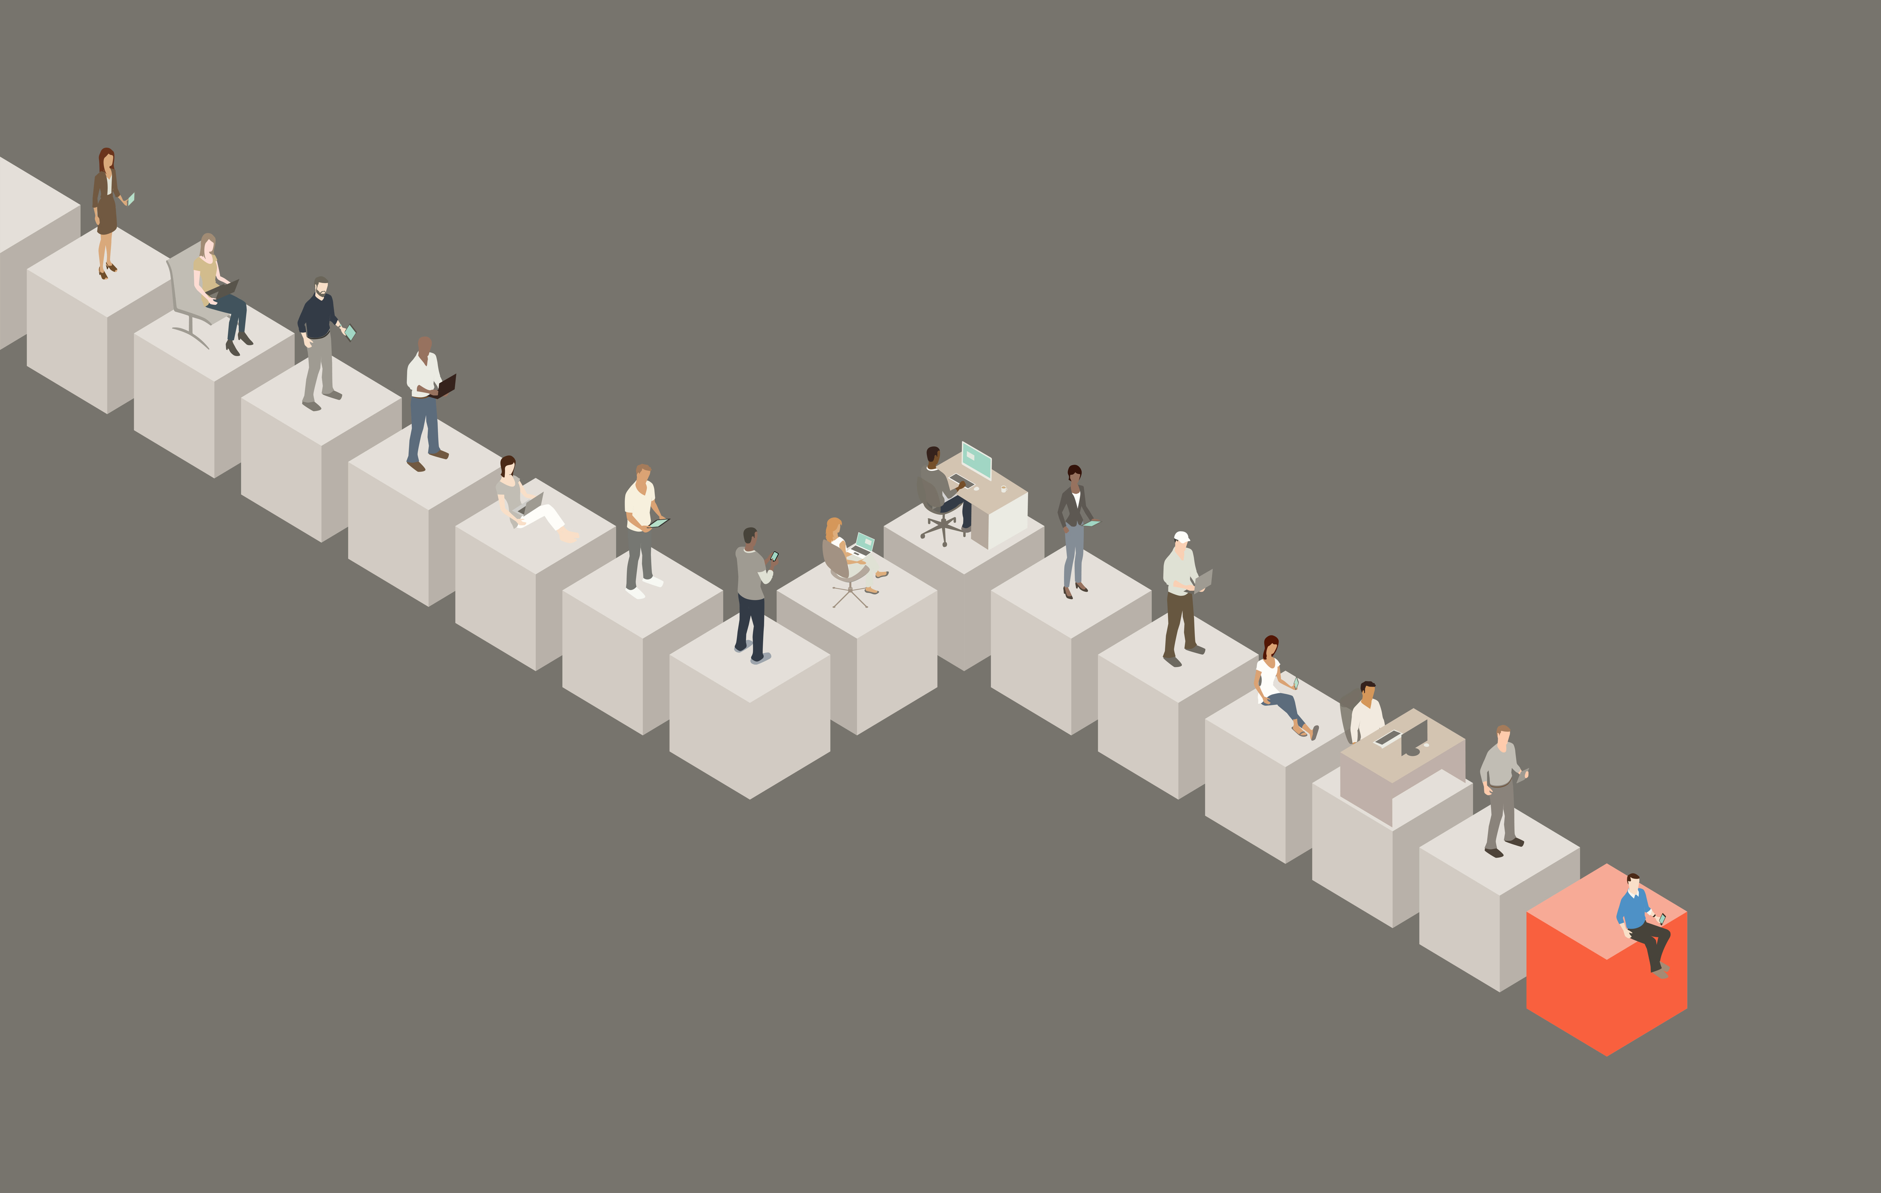
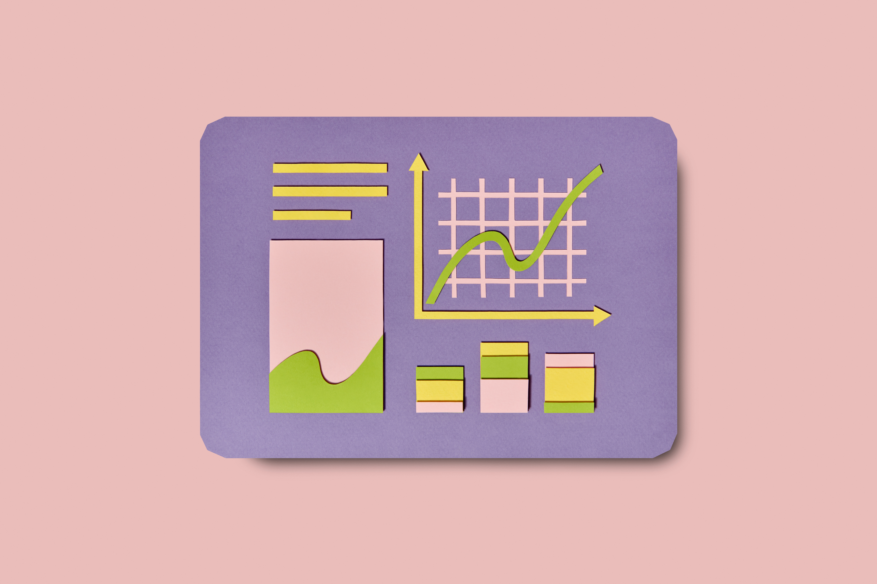
Dataset Explanation
Dataset provides a detailed overview of consumer preferences and purchasing behaviors. It includes demographic information, purchase history, product preferences, and preferred shopping channels (online or offline).
This dataset is essential for businesses aiming to tailor their strategies to meet customer needs and enhance their shopping experience, ultimately driving sales and loyalty.
With this rich collection of data, analysts and researchers can delve into the intricacies of consumer decision-making processes, aiding businesses in crafting targeted marketing strategies, optimizing product offerings, and enhancing overall customer satisfaction.

Slide 11
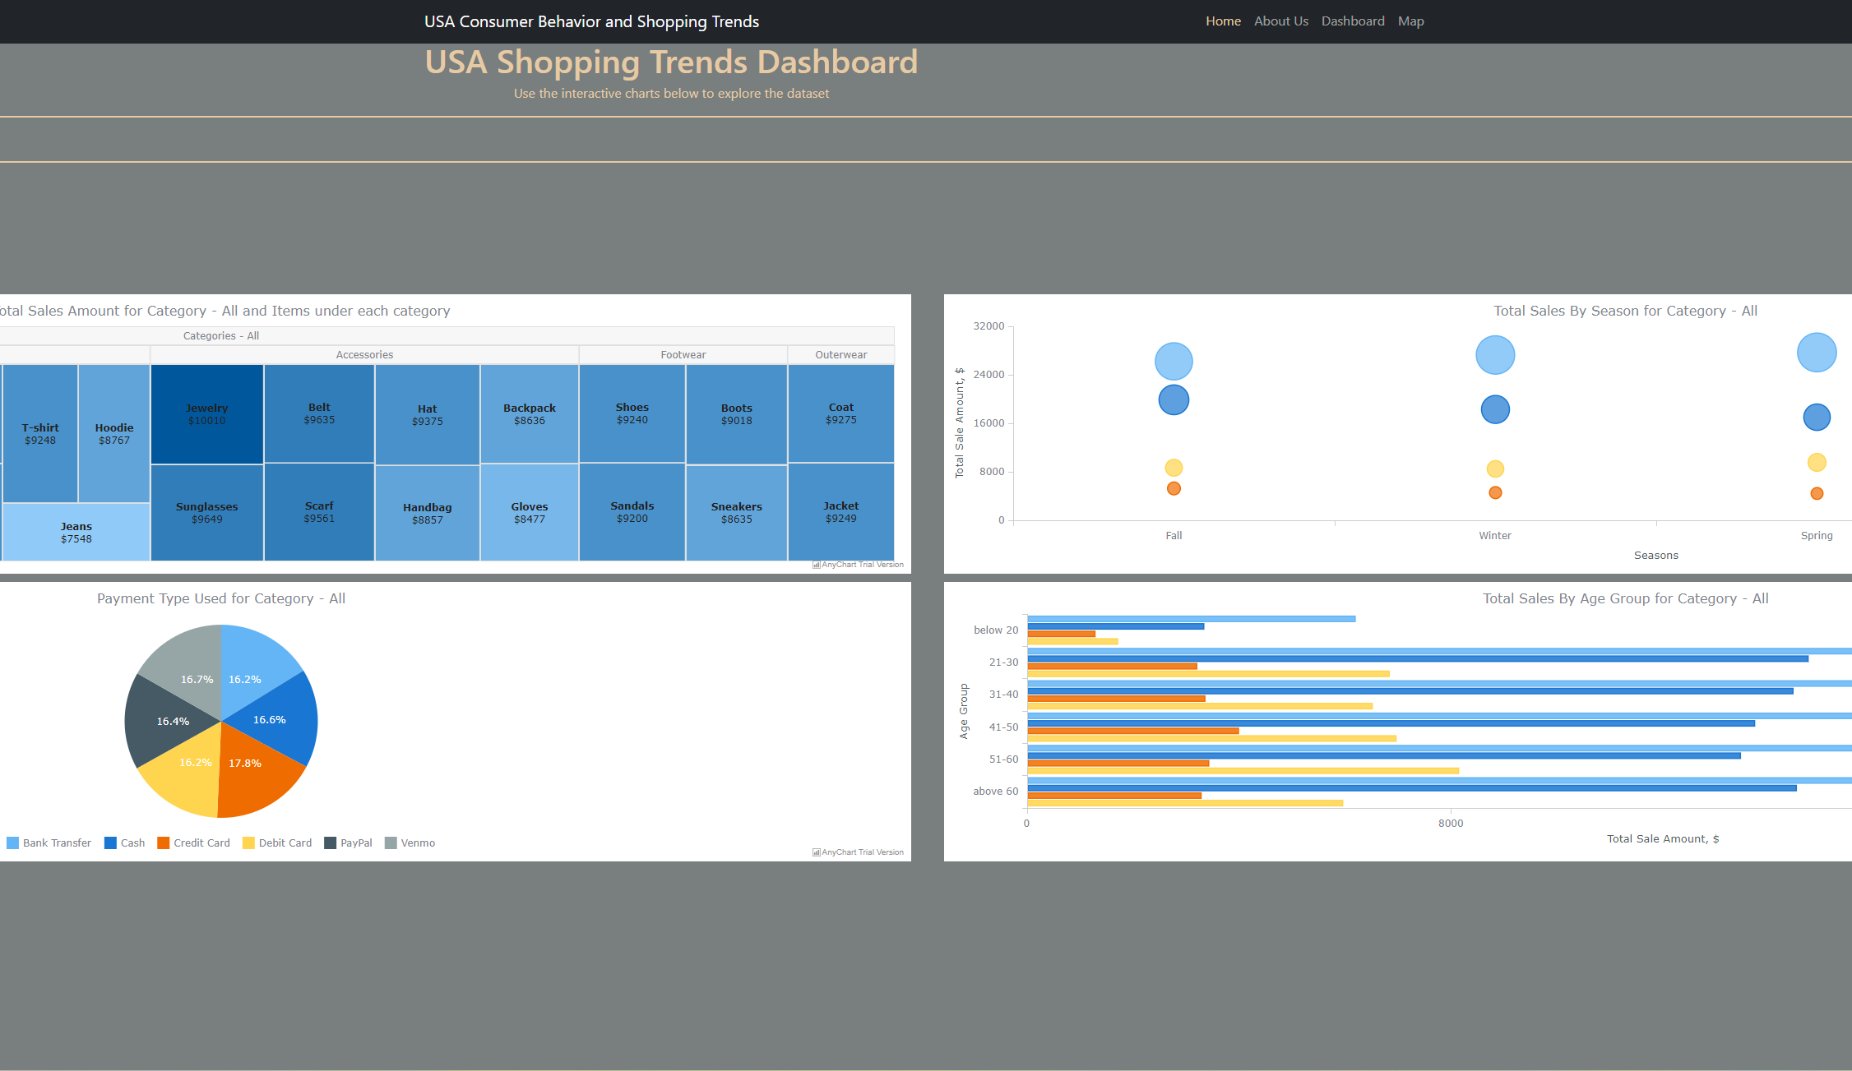
Dashboard
Website’s dashboard offers interactive visualization.
Data is provided for all and specific shopping categories (clothing, outwear, footwear and accessories)
Tree map, Bubble chart, Pie chart and Horizontal Bar chart gives various views of the data for the shopping categories.

Slide 12
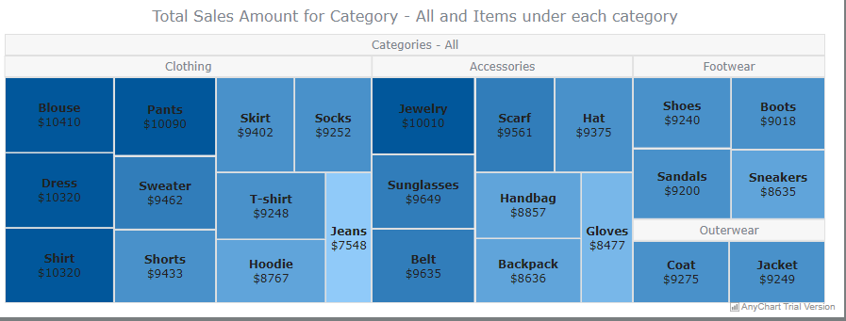
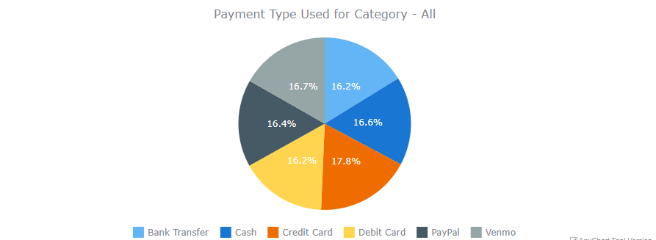
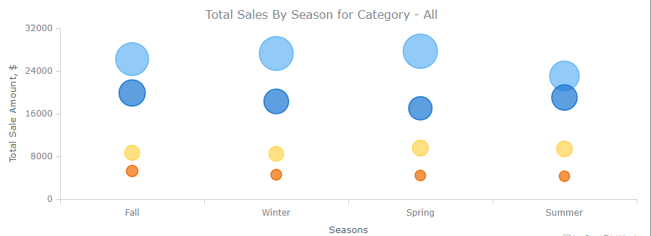
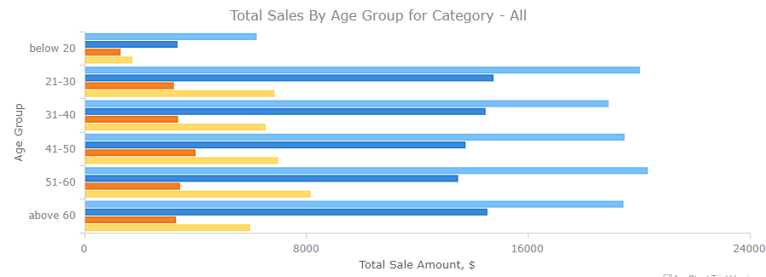
Dashboard Graphs for All Categories
Payment Type used for All categories
Total sales amount for All Categories and Items under each category
Total Sales - Season for All categories
Total Sales - Age Group for All categories

Slide 13
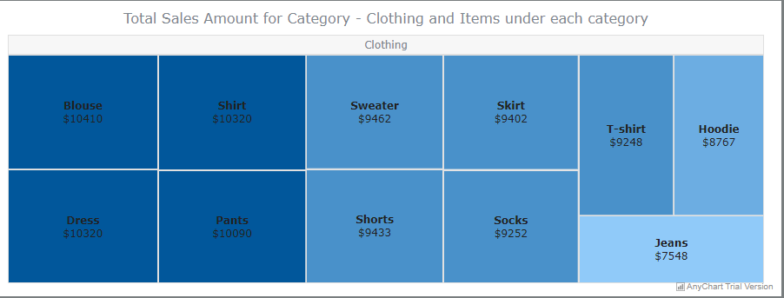
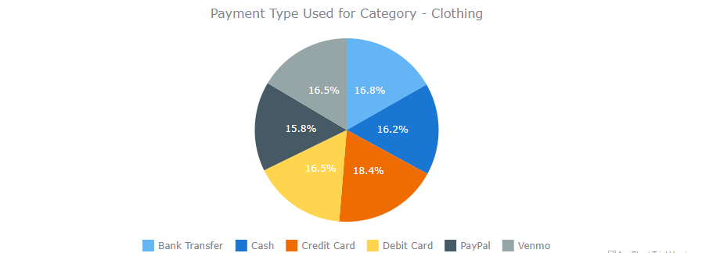
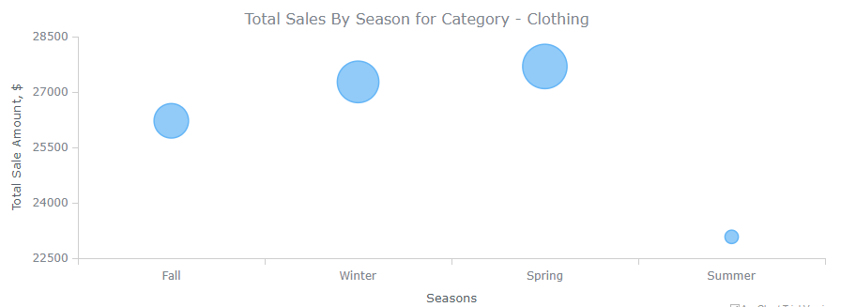
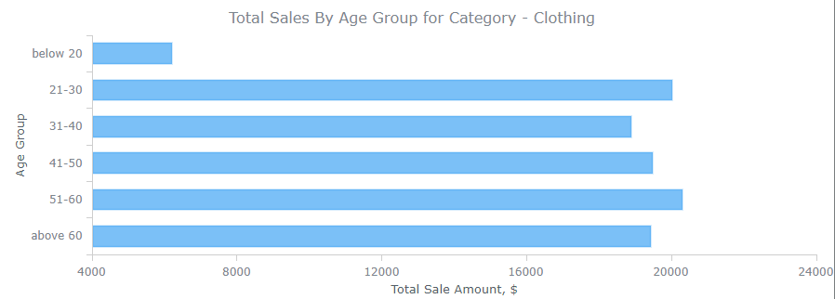
Dashboard Graphs for Clothing Category
Total sales amount for Clothing category & items under it
Payment Type used for Clothing category
Total Sales - Season for Clothing category
Total Sales - Age Group for Clothing category

Slide 14
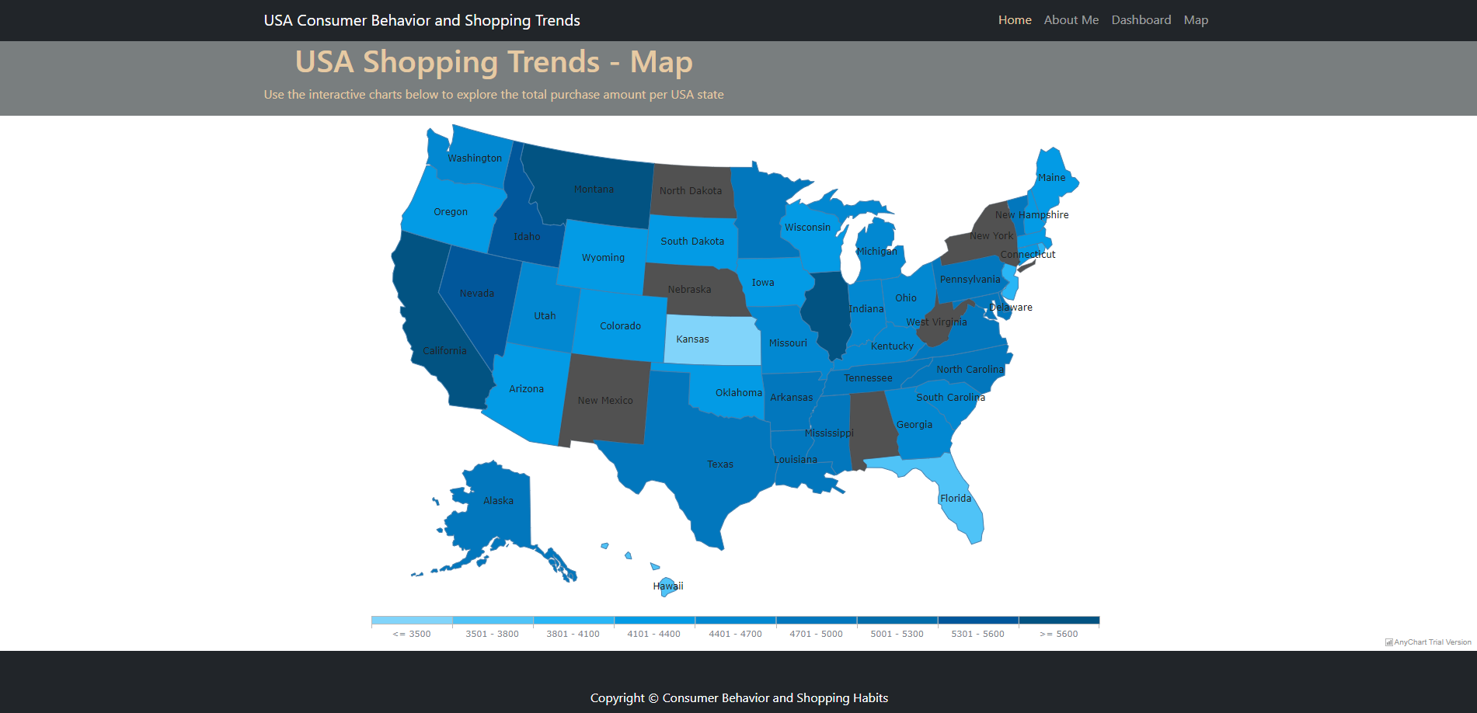
Map

Slide 15

Ethical Considerations
Ethical considerations are of paramount importance, they ensure responsible and transparent handling of data to protect user privacy and maintain the integrity
Key considerations in this project
Privacy Protection
Transparency in Data Sourcing
Inclusive Representation
User Consent
Responsible Data Handling
Accessible Design
Security Measures

Slide 16



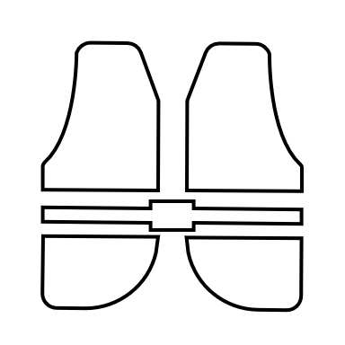

Key Takeaways
Clothes are the most shopped category
Most Footwear sales happen in the Spring season
Most Outerwear are purchased by Cash payment method
Age Group 21-30 purchase the most Accessories

Slide 17



Conclusion
California, Montana and Illinois have the most amount of Sales
Winter and Spring seasons see the most sales in Clothing
Consumers mostly use credit card for making purchases

Slide 18

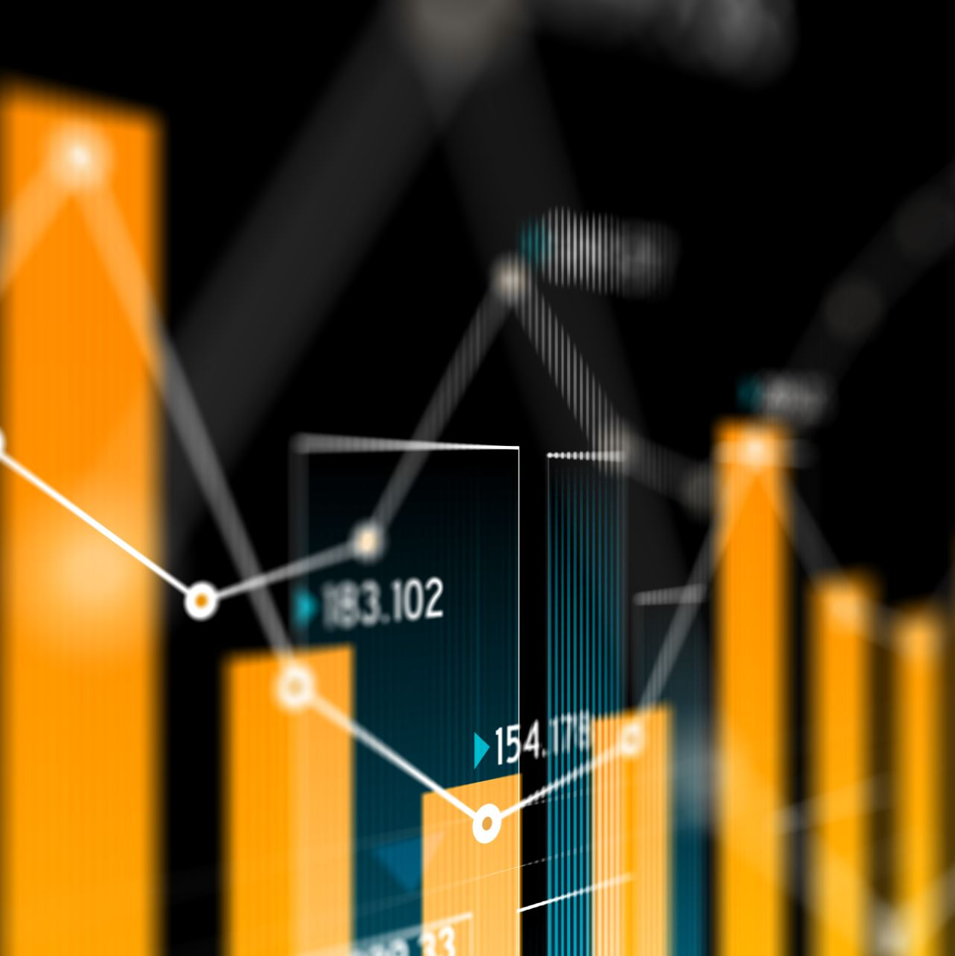

Thank you!
Nidhi Ojha
https://www.linkedin.com/in/nidhimishraojha/

